Slide 1

Slides developed by Mine Çetinkaya-Rundel of OpenIntro
Translated from LaTeX to Google Slides by Curry W. Hilton of OpenIntro.
The slides may be copied, edited, and/or shared via the CC BY-SA license
To make a copy of these slides, go to File > Download as > [option], as shown below. Or if you are logged into a Google account, you can choose Make a copy... to create your own version in Google Drive.

Slide 2
Difference in two means
Slides developed by Mine Çetinkaya-Rundel of OpenIntro
Translated from LaTeX to Google Slides by Curry W. Hilton of OpenIntro.
The slides may be copied, edited, and/or shared via the CC BY-SA license
Some images may be included under fair use guidelines (educational purposes)

Slide 3

Diamonds
Weights of diamonds are measured in carats
1 carat = 100 points, 0.99 carats = 99 points, etc.
The difference between the size of a 0.99 carat diamond and a 1 carat diamond is undetectable to the naked human eye, but does the price of a 1 carat diamond tend to be higher than the price of a 0.99 diamond?
We are going to test to see if there is a difference between the average prices of 0.99 and 1 carat diamonds
In order to be able to compare equivalent units, we divide the prices of 0.99 carat diamonds by 99 and 1 carat diamonds by 100, and compare the average point prices

Slide 4
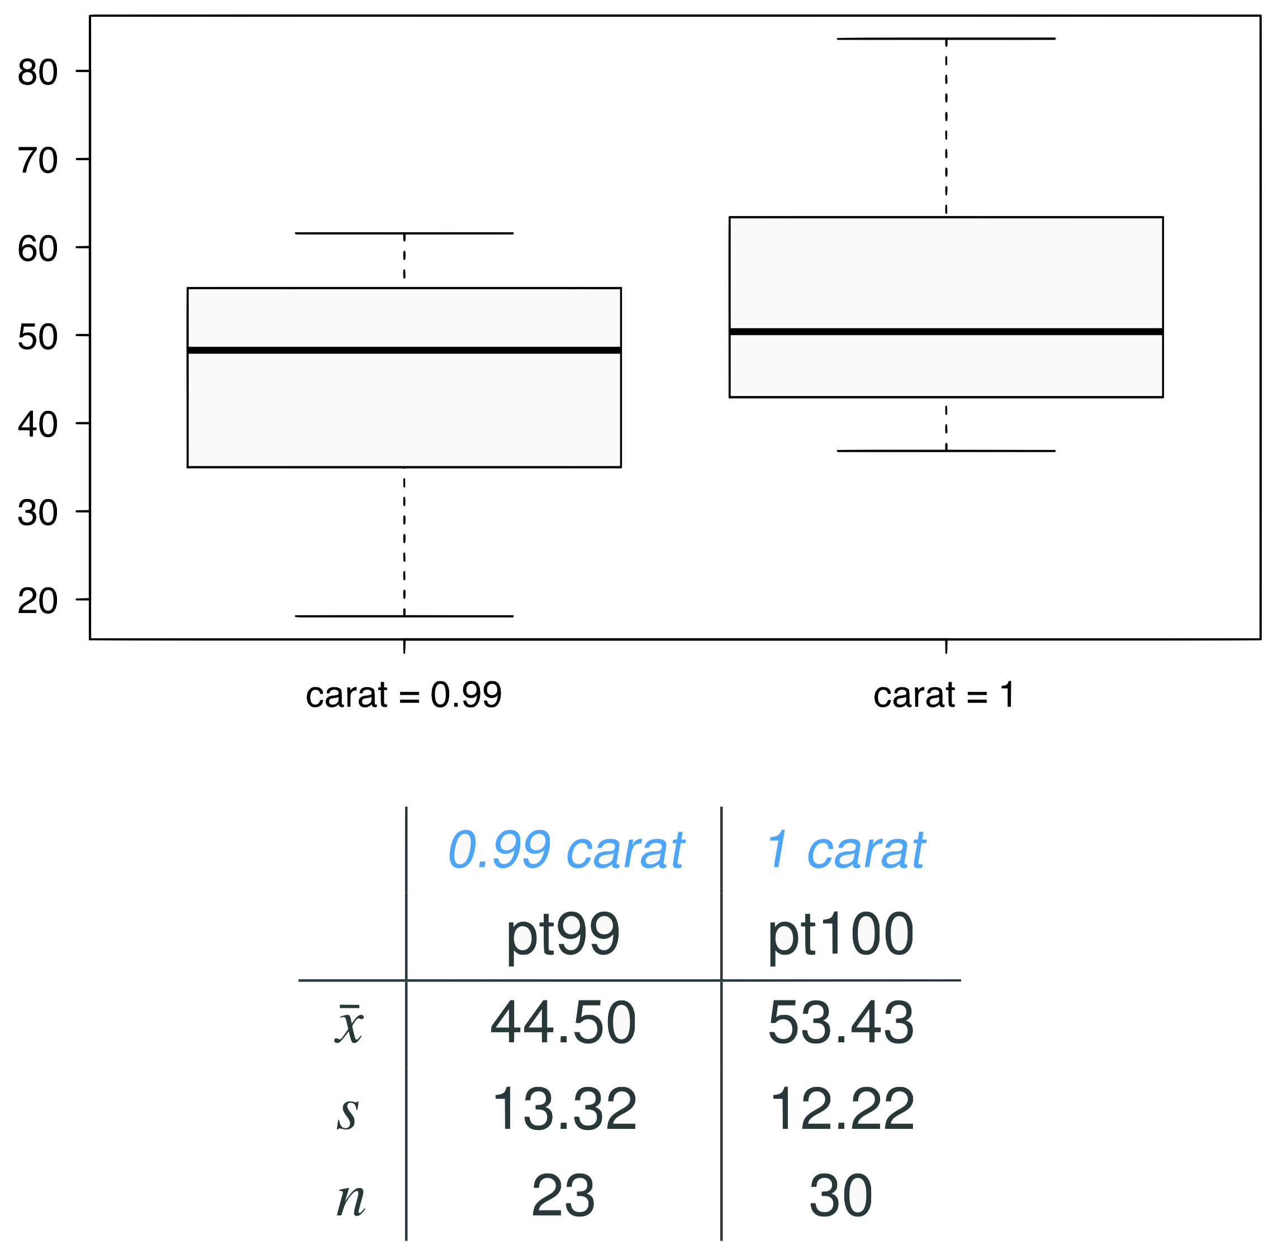
Data
Note: These data are a random sample from the diamonds data set in ggplot2 R package.

Slide 5

Parameter and point estimate
Parameter of interest: Average difference between the point prices of all 0.99 carat and 1 carat diamonds

Slide 6

Parameter and point estimate
Parameter of interest: Average difference between the point prices of all 0.99 carat and 1 carat diamonds
Point estimate: Average difference between the point prices of sampled 0.99 carat and 1 carat diamonds

Slide 7


Hypotheses
Which of the following is the correct set of hypotheses for testing if the average point price of 1 carat diamonds (pt100) is higher than the average point price of 0.99 carat diamonds (pt99)?
H₀ : 𝞵_{pt99} = 𝞵_{pt100}
H_{A} : 𝞵_{pt99} ≠ 𝞵_{pt100}
H₀ : 𝞵_{pt99} = 𝞵_{pt100}
H_{A} : 𝞵_{pt99} > 𝞵_{pt100}
H₀ : 𝞵_{pt99} = 𝞵_{pt100}
H_{A} : 𝞵_{pt99} < 𝞵_{pt100}
H₀ :
H_{A} :

Slide 8
Hypotheses
Which of the following is the correct set of hypotheses for testing if the average point price of 1 carat diamonds (pt100) is higher than the average point price of 0.99 carat diamonds (pt99)?
H₀ : 𝞵_{pt99} = 𝞵_{pt100}
H_{A} : 𝞵_{pt99} ≠ 𝞵_{pt100}
H₀ : 𝞵_{pt99} = 𝞵_{pt100}
H_{A} : 𝞵_{pt99} > 𝞵_{pt100}
H₀ : 𝞵_{pt99} = 𝞵_{pt100}
H_{A} : 𝞵_{pt99} < 𝞵_{pt100}
H₀ :
H_{A} :

Slide 9
Conditions
Which of the following does not need to be satisfied in order to conduct this hypothesis test using theoretical methods?
Point price of one 0.99 carat diamond in the sample should be independent of another, and the point price of one 1 carat diamond should independent of another as well
Point prices of 0.99 carat and 1 carat diamonds in the sample should be independent.
Distributions of point prices of 0.99 and 1 carat diamonds should not be extremely skewed
Both sample sizes should be at least 30

Slide 10
Conditions
Which of the following does not need to be satisfied in order to conduct this hypothesis test using theoretical methods?
Point price of one 0.99 carat diamond in the sample should be independent of another, and the point price of one 1 carat diamond should independent of another as well
Point prices of 0.99 carat and 1 carat diamonds in the sample should be independent.
Distributions of point prices of 0.99 and 1 carat diamonds should not be extremely skewed
Both sample sizes should be at least 30

Slide 11
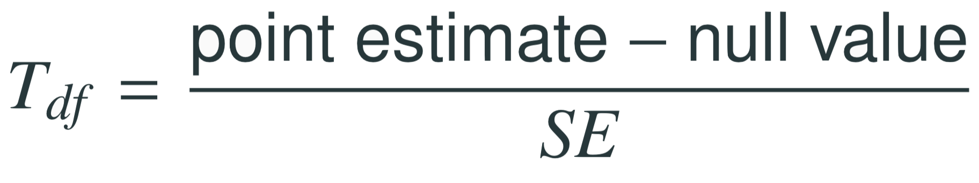
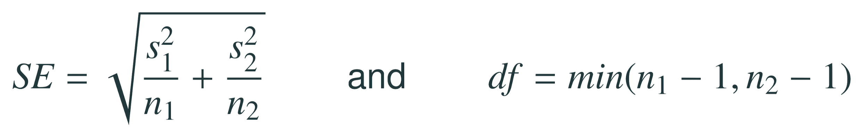
Test statistics
Test statistic for inference on the difference of two small sample means
The test statistic for inference on the difference of two means where σ₁ and σ₂ are unknown is the T statistic.
where
Note: The calculation of the df is actually much more complicated. For simplicity we’ll use the above formula to estimate the true df when conducting the analysis by hand

Slide 12
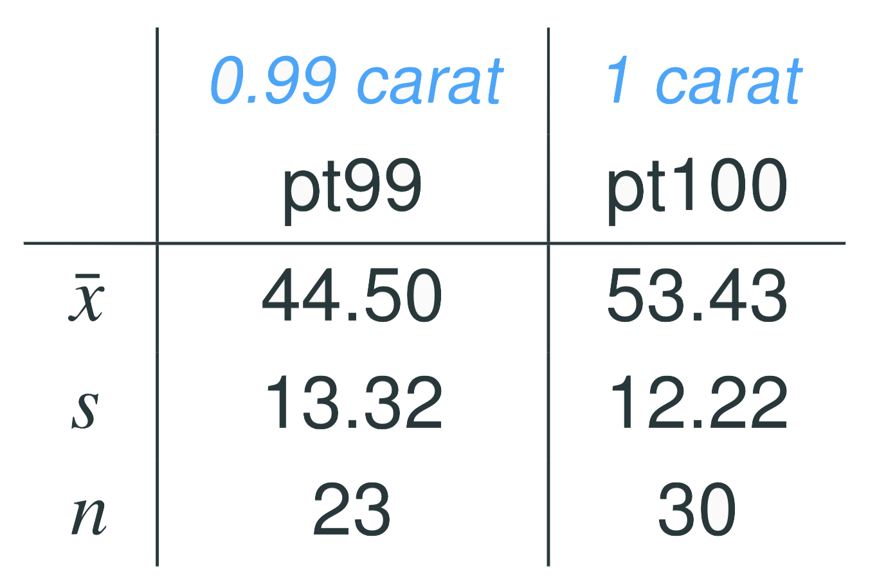
Test statistics (cont.)
In context...

Slide 13
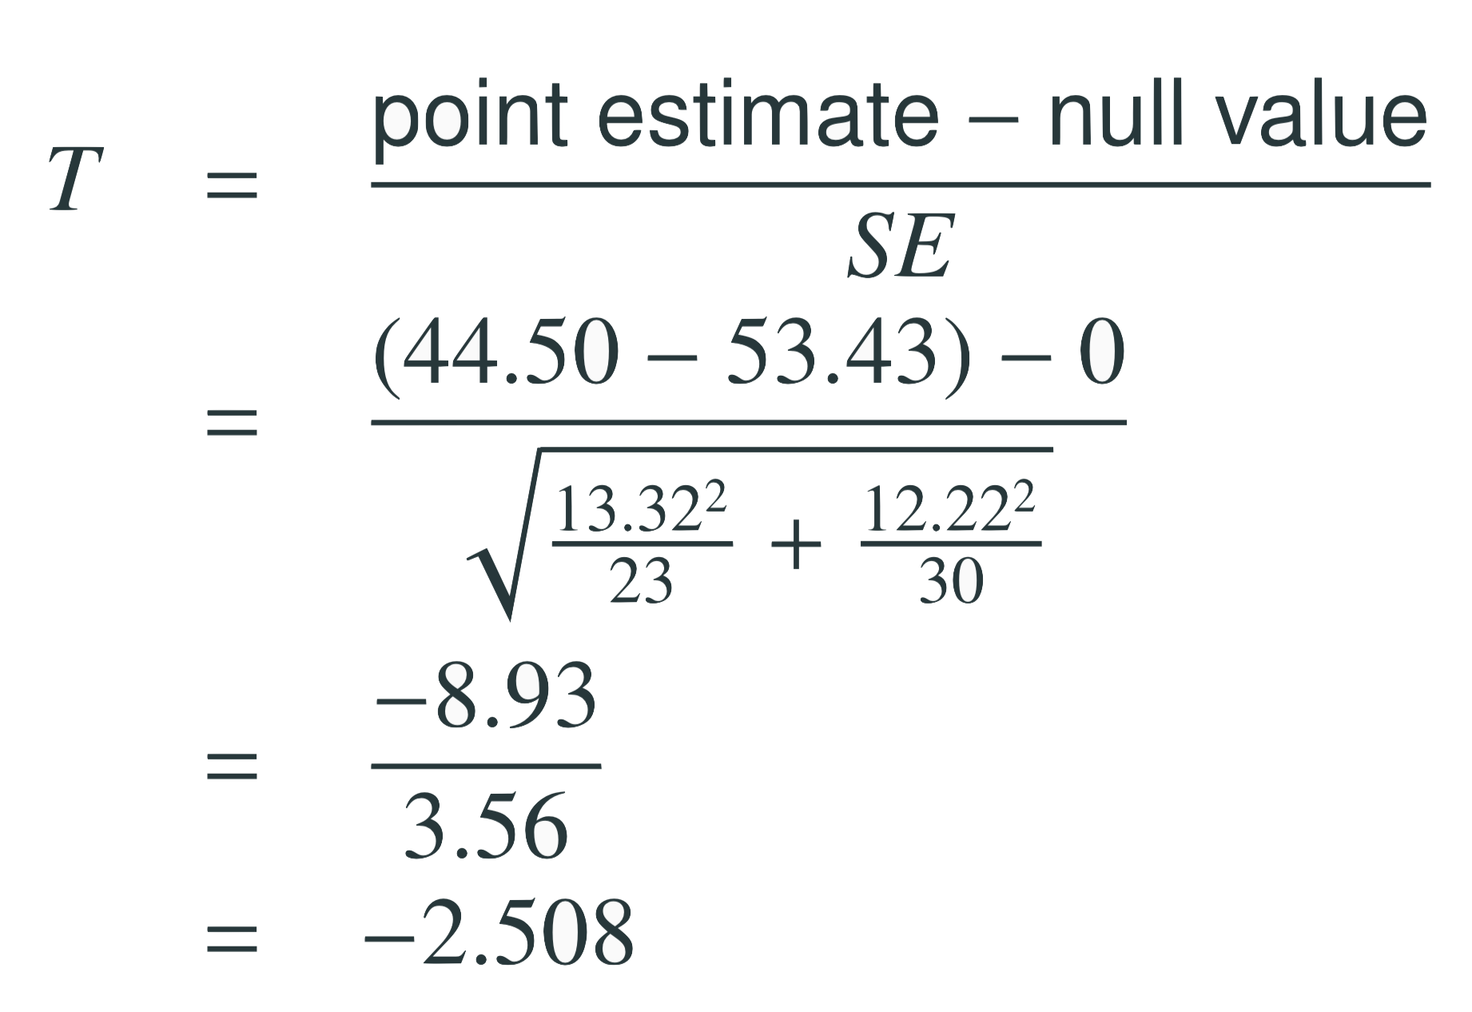
Test statistics (cont.)
In context...

Slide 14
Test statistics (cont.)
In context...

Slide 15
Test statistics (cont.)
In context...

Slide 16
Test statistics (cont.)
In context...

Slide 17
Test statistics (cont.)
Which of the following is the correct df for this hypothesis test?
22
23
30
29
52

Slide 18



Test statistics (cont.)
Which of the following is the correct df for this hypothesis test?
22
23
30
29
52

Slide 19


p-value
Which of the following is the correct p-value for this hypothesis test?
between 0.005 and 0.01
between 0.01 and 0.025
between 0.02 and 0.05
between 0.01 and 0.02

Slide 20
p-value
Which of the following is the correct p-value for this hypothesis test?
between 0.005 and 0.01
between 0.01 and 0.025
between 0.02 and 0.05
between 0.01 and 0.02
> pt(q = -2.508, df = 22)
[1] 0.0100071

Slide 21
Synthesis
What is the conclusion of the hypothesis test? How (if at all) would this conclusion change your behavior if you went diamond shopping?

Slide 22
Synthesis
What is the conclusion of the hypothesis test? How (if at all) would this conclusion change your behavior if you went diamond shopping?
p-value is small so reject H₀. The data provide convincing evidence to suggest that the point price of 0.99 carat diamonds is lower than the point price of 1 carat diamonds
Maybe buy a 0.99 carat diamond? It looks like a 1 carat, but is significantly cheaper

Slide 23
Equivalent confidence level
What is the equivalent confidence level for a one-sided hypothesis test at α = 0.05?
90%
92.5%
95%
97.5%

Slide 24
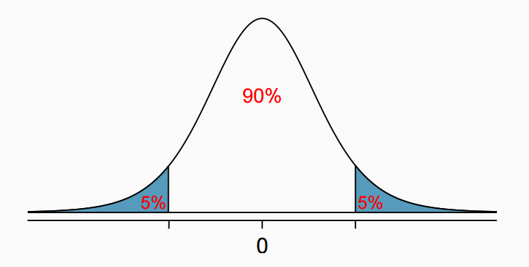
Equivalent confidence level
What is the equivalent confidence level for a one-sided hypothesis test at α = 0.05?
90%
92.5%
95%
97.5%

Slide 25
Critical value
What is the appropriate 𝙩* for a confidence interval for the average difference between the point prices of 0.99 and 1 carat diamonds?
1.32
1.72
2.07
2.82

Slide 26
Critical value
What is the appropriate 𝙩* for a confidence interval for the average difference between the point prices of 0.99 and 1 carat diamonds?
1.32
1.72
2.07
2.82
> qt(p = 0.95, df = 22)
[1] 1.717144

Slide 27

Confidence interval
Calculate the interval, and interpret it in context

Slide 28
Confidence interval
Calculate the interval, and interpret it in context

Slide 29

Confidence interval
Calculate the interval, and interpret it in context

Slide 30

Confidence interval
Calculate the interval, and interpret it in context

Slide 31
Confidence interval
Calculate the interval, and interpret it in context
We are 90% confident that the average point price of a 0.99 carat diamond is $15.05 to $2.81 lower than the average point price of a 1 carat diamond

Slide 32

Recap: Inference using difference of two small sample means
If σ₁ or σ₂ is unknown, difference between the sample means follow a 𝙩-distribution with

Slide 33
Recap: Inference using difference of two small sample means
If σ₁ or σ₂ is unknown, difference between the sample means follow a 𝙩-distribution with
Conditions:
independence within groups (often verified by a random sample, and if sampling without replacement, n < 10% of population) and between groups
no extreme skew in either group

Slide 34
Recap: Inference using difference of two small sample means
If σ₁ or σ₂ is unknown, difference between the sample means follow a 𝙩-distribution with
Conditions:
independence within groups (often verified by a random sample, and if sampling without replacement, n < 10% of population) and between groups
no extreme skew in either group
Hypothesis testing:

Slide 35

Recap: Inference using difference of two small sample means
If σ₁ or σ₂ is unknown, difference between the sample means follow a 𝙩-distribution with
Conditions:
independence within groups (often verified by a random sample, and if sampling without replacement, n < 10% of population) and between groups
no extreme skew in either group
Hypothesis testing:
Confidence interval:

Slide 36
Find more resources at openintro.org/os, including
Slides
Videos
Statistical Software Labs
Discussion Forums (free support for students and teachers)
Learning Objectives
Teachers only content is also available for Verified Teachers, including
Exercise solutions
Sample exams
Ability to request a free desk copy for a course
Statistics Teachers email group
Questions? Contact us.

Slide 37
Extra Slides from the OS3 section on difference of two means

Slide 38
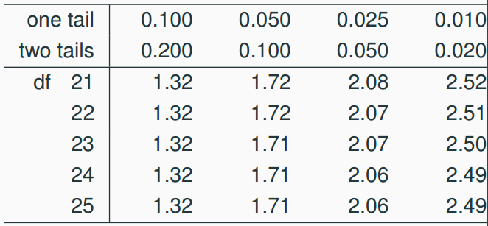
p-value
Which of the following is the correct p-value for this hypothesis test?
between 0.005 and 0.01
between 0.01 and 0.025
between 0.02 and 0.05
between 0.01 and 0.02

Slide 39
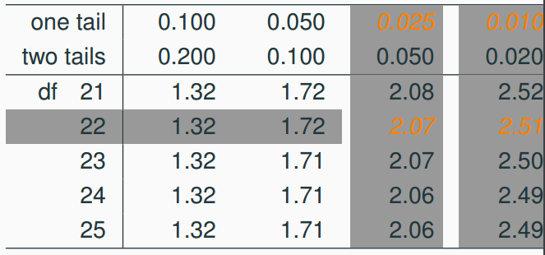
p-value
Which of the following is the correct p-value for this hypothesis test?
between 0.005 and 0.01
between 0.01 and 0.025
between 0.02 and 0.05
between 0.01 and 0.02

Slide 40
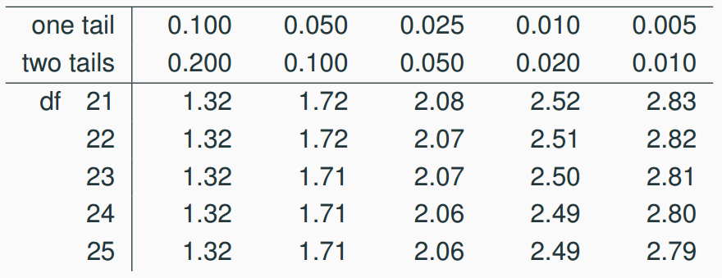
Critical value
What is the appropriate 𝙩* for a confidence interval for the average difference between the point prices of 0.99 and 1 carat diamonds?
1.32
1.72
2.07
2.82

Slide 41
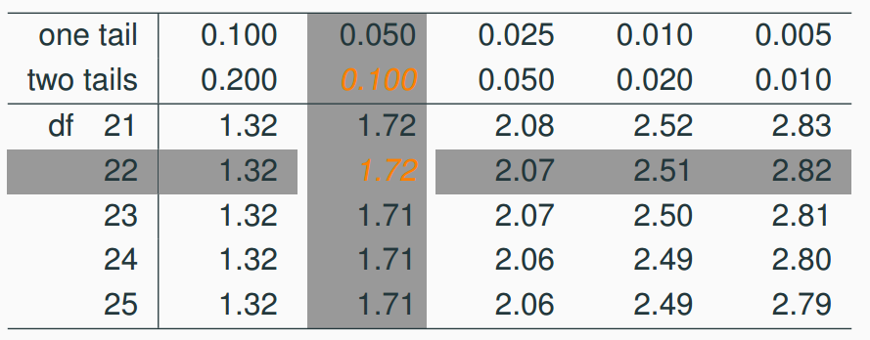
Critical value
What is the appropriate 𝙩* for a confidence interval for the average difference between the point prices of 0.99 and 1 carat diamonds?
1.32
1.72
2.07
2.82

